Slide 1
Randolph County growth management policies
Hal Johnson
County Planning Director

Slide 2
Growth Management Policies
Sustainable economic growth
Environmental protection
Quality of life linkage as mutually supporting public policy goals

Slide 3
Growth Management Plan Goals & Objectives
Recognize that all individual growth management decisions are part of a larger interconnecting framework of building sustainable and quality growth within Randolph County;
Discourage high density development in areas where significant urban infrastructure are not anticipated;
Encourage rural lot designs in those areas where urban infrastructure is not anticipated that will enhance groundwater recharge ability while preserving open space;

Slide 4
Growth Management Plan Goals & Objectives
Recognize that growth management policies should afford flexibility to County boards and agencies that will enable them to adapt to the practical requirements often necessary for rural development; and
Performance zoning criteria, such as open space or heritage asset preservation, should help expedite development project approval.

Slide 5
Summary of Growth Management Areas
Growth Corridors
Primary Growth Area
Secondary Growth Area
Rural Growth Area
Municipal Growth Area
Interconnected Development Policies

Slide 6
Summary of Growth Management Areas
Flexible Rural Subdivision Options
Enhance groundwater recharge areas
Reduce erosion and stormwater run-off into stream and adjoining properties
Development Impact Analysis
Agri-Business Preservation/Voluntary Agricultural Districts

Slide 7
Summary of Proposed Amendments
Major Residential Subdivision Overlay Districts
Conventional
Rural Residential (Large lot)
Conservation (50% open space)
Development Impact Analysis
Public education
Water resources
Traffic analysis
Area housing characteristics

Slide 8
Summary of Proposed Amendments
Neighborhood Information Meeting
Community input
Technical review
Formal staff recommendation
Specialized Commercial/Rural Industrial Overlay Districts
Industrial Overlay
Rural Business
Commercial Environmental Overlay

Slide 9
Issues Affecting Rural Sprawl and Quality of Life
Growth Management Plan = Linkage
Rural conservation and growth
Large lot zoning (?) v. Open Space (?)
Open space and Heritage asset preservation
Voluntary farmland preservation – Private land owner strategies
County/Municipal Infrastructures Policies
Major Subdivision Development
Definition
Rezoning
Design standards
Open space – 50%
Minimum lot size: base density and flexibility

Slide 10
Issues Affecting Rural Sprawl and Quality of Life
Density bonus – one additional lot
Each additional 5% open space
Preservation of designated heritage sites based on site priority designation
Maintain forestation and natural buffers
Approved forestation plan for open space
200 ft. setback for each 500 ft. existing road frontage
Heritage Asset and Scenic Corridor Protection
Accommodate growth and co-exist

Slide 11
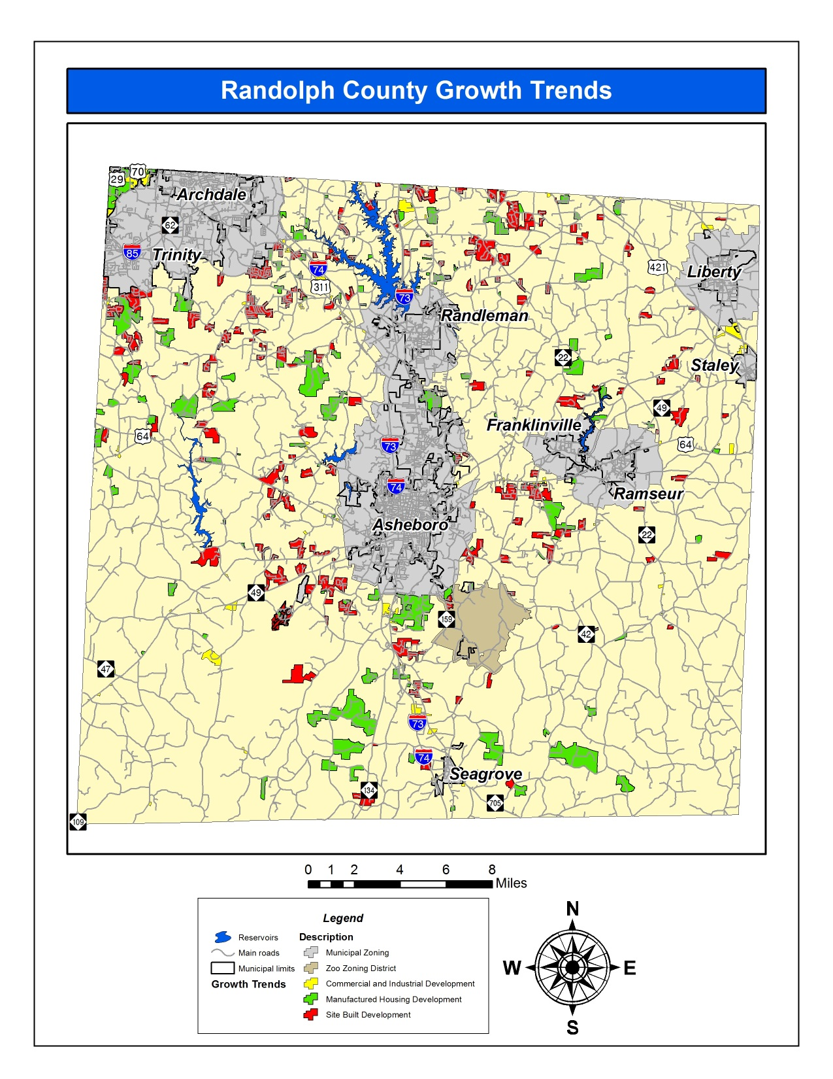

Slide 12
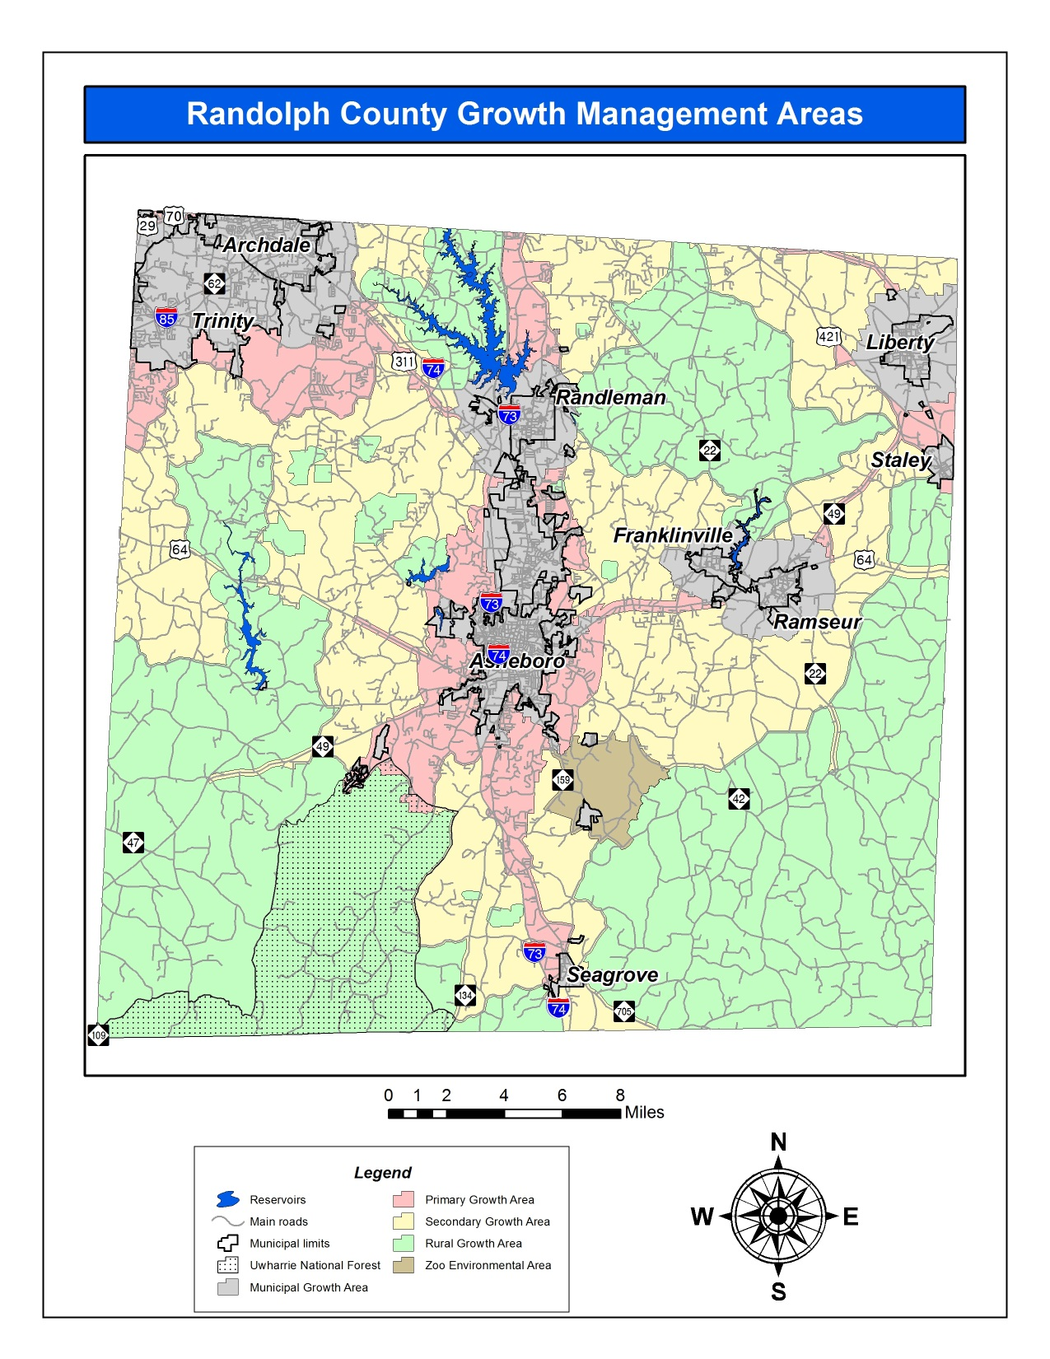

Slide 13
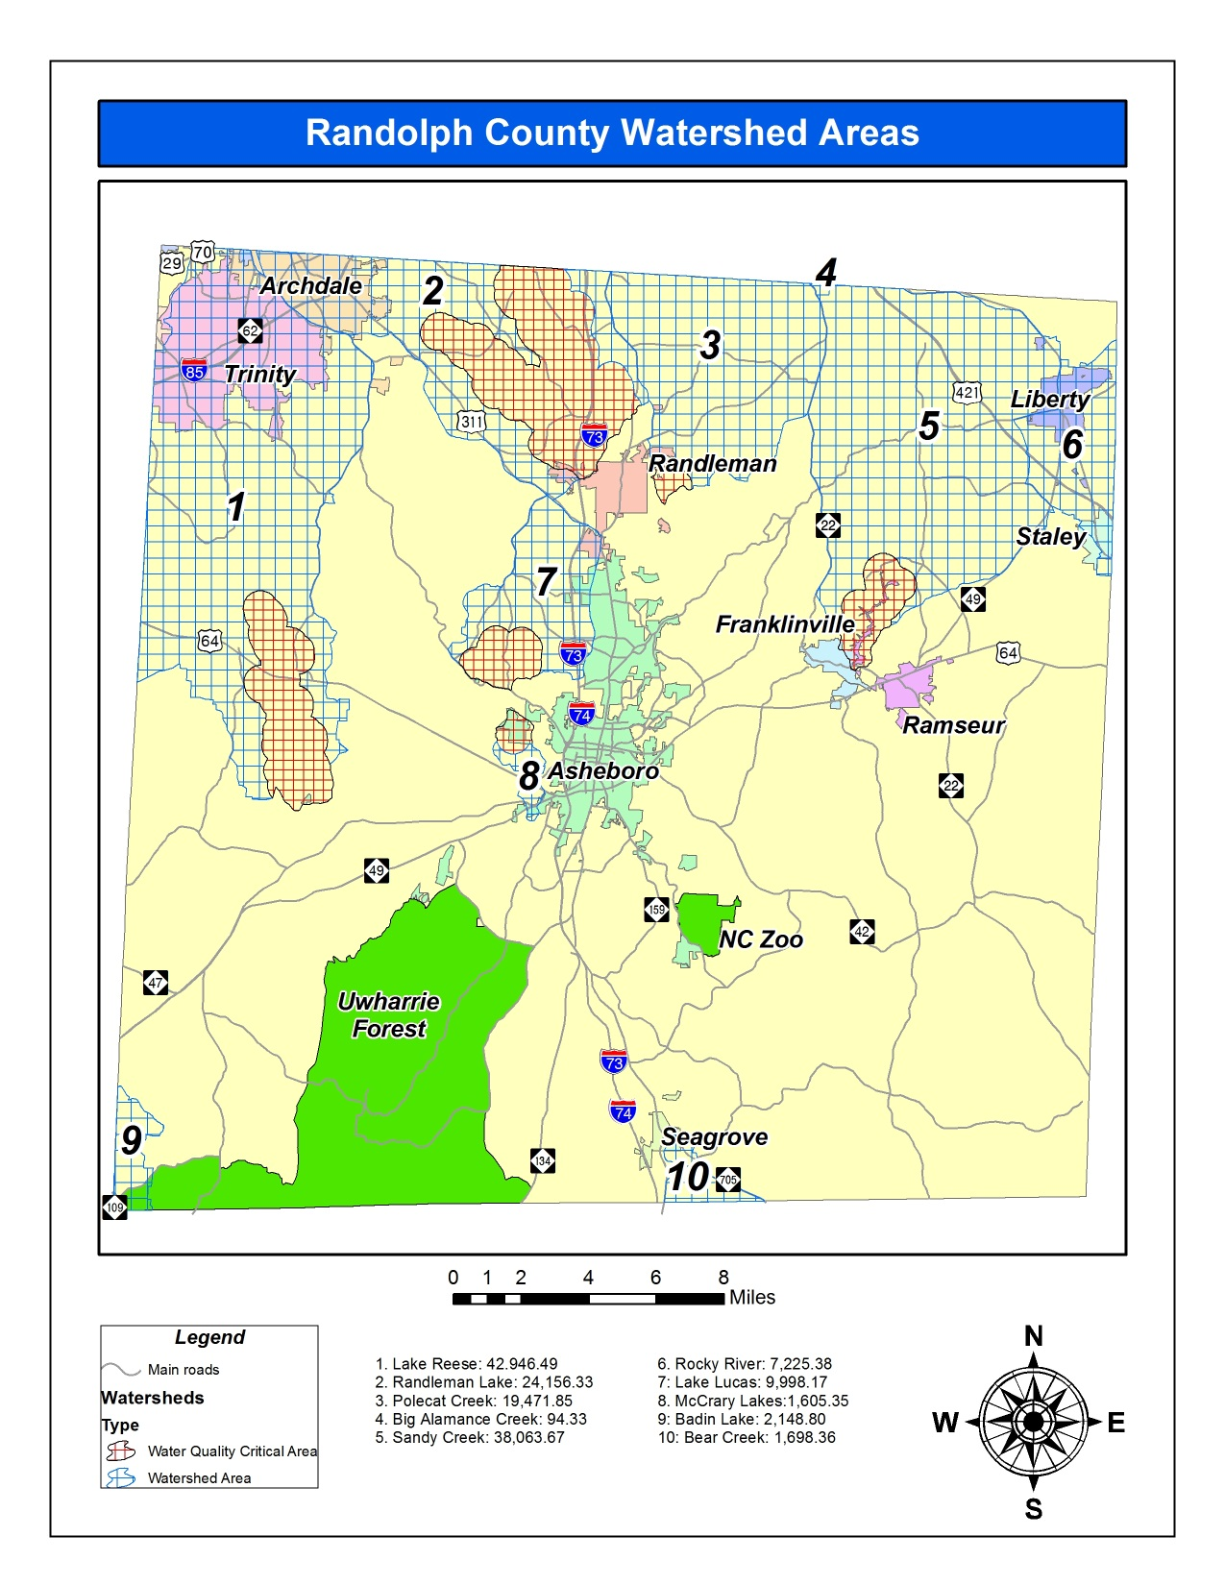

Slide 14
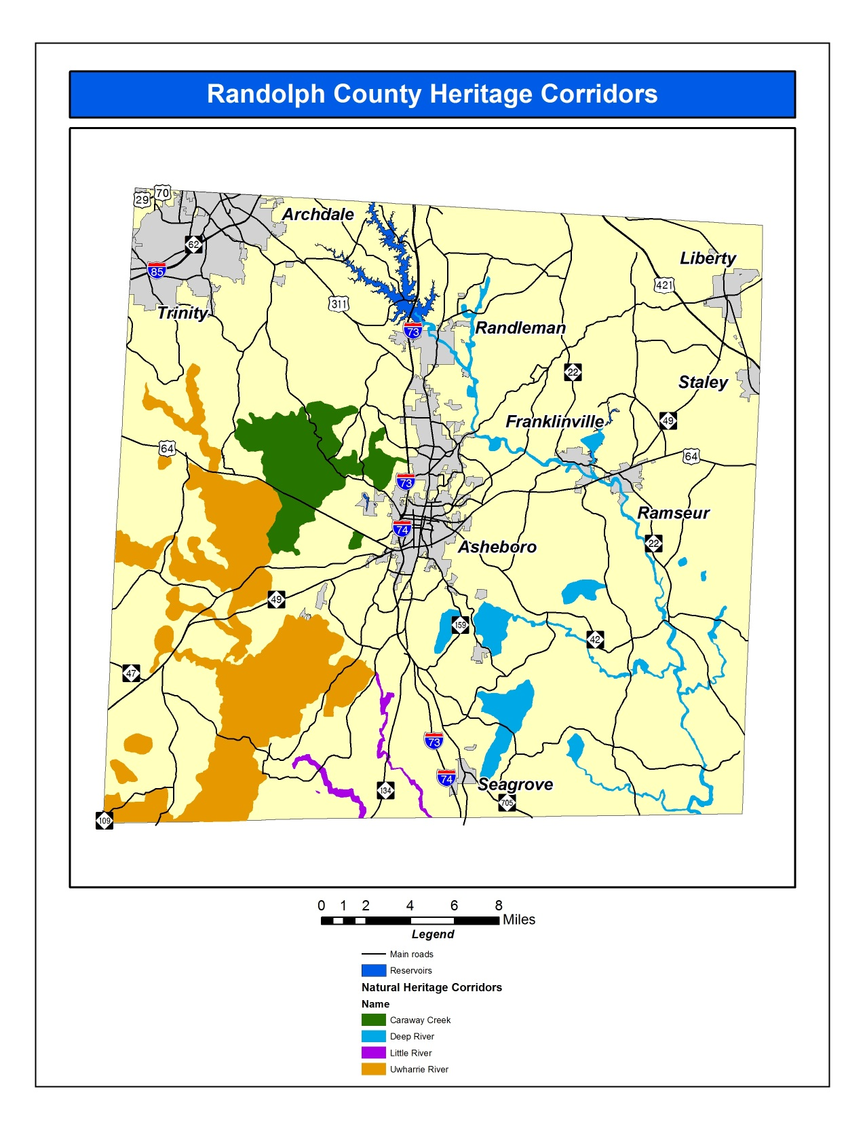

Slide 15
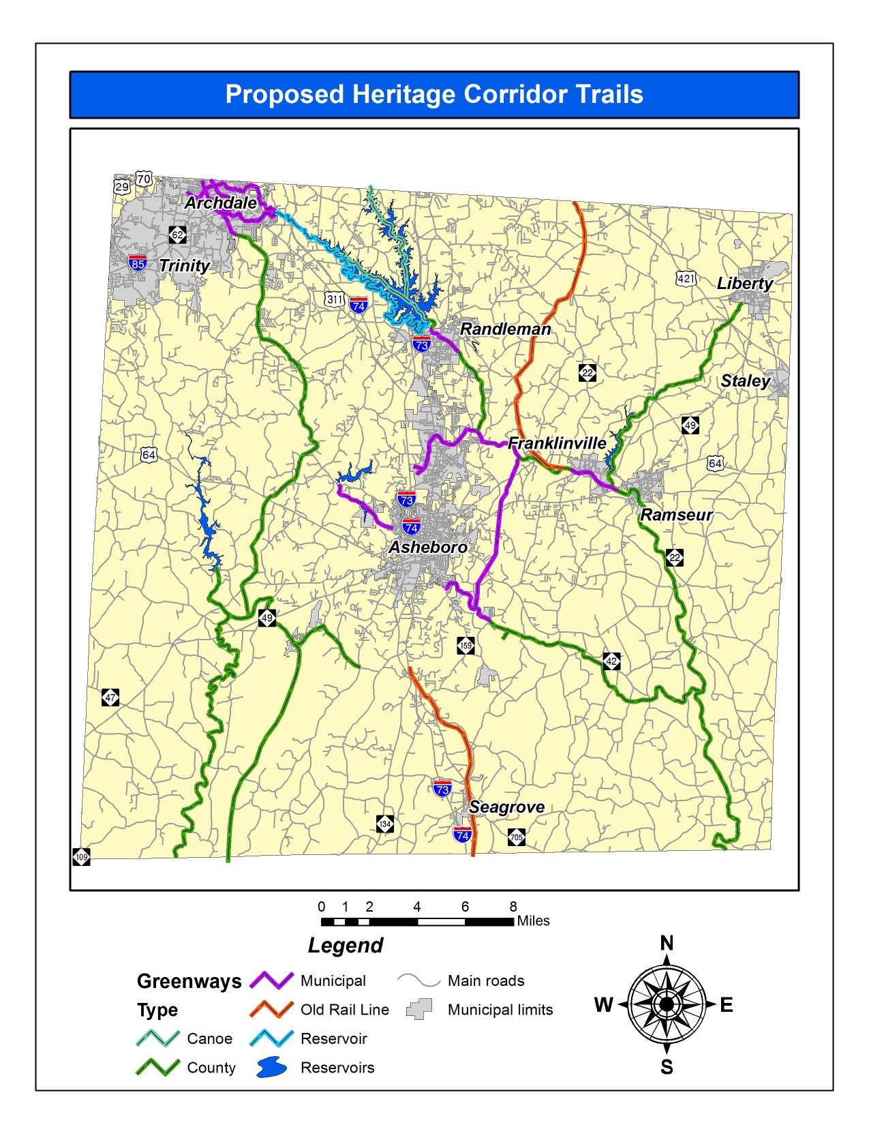

Slide 16
